Slide 1

Overview of RPA
RPA enables the automation of repetitive, rules-based tasks
RPA is commonly used to facilitate data transfers between systems without integration capabilities
Ideal RPA candidates are tasks that are manual, time-intensive, error-prone, and follow clear decision rules
However, the advent of generative AI and LLMs is extending RPA’s applicability to more complex, less deterministic workflows through the use of intelligent agents
RPA workflows can be developed in two main ways:
Writing custom code from the ground up
Using low-code/no-code platforms with graphical interfaces, such as UiPath Studio, Automation Anywhere, and Blue Prism
Private & Confidential

Slide 2
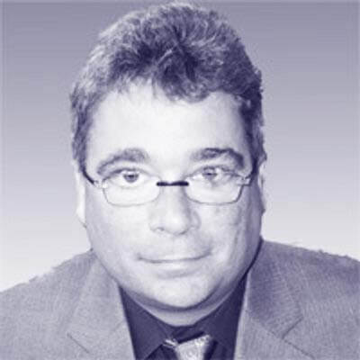
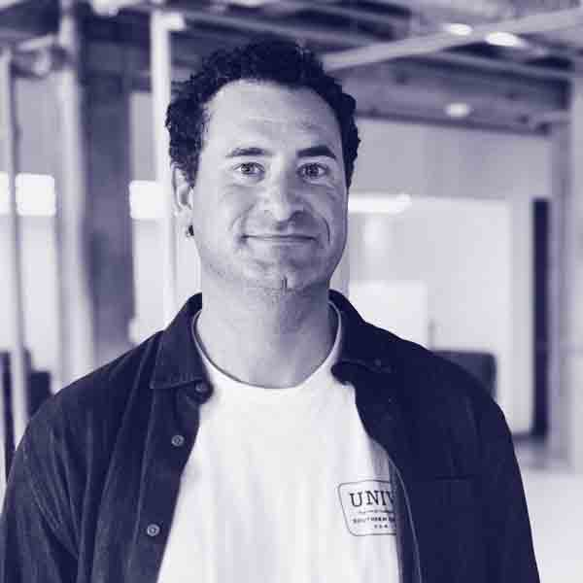
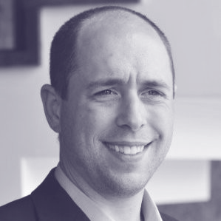
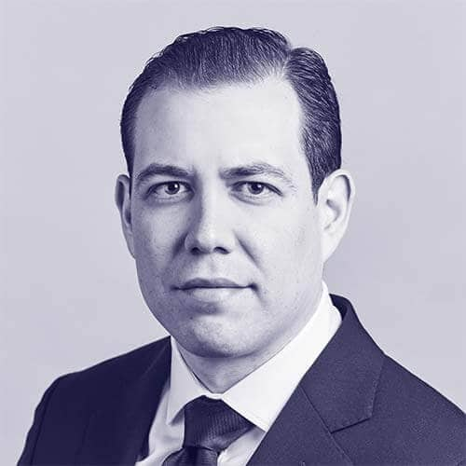
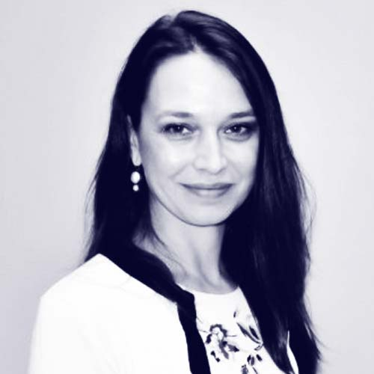
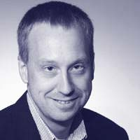

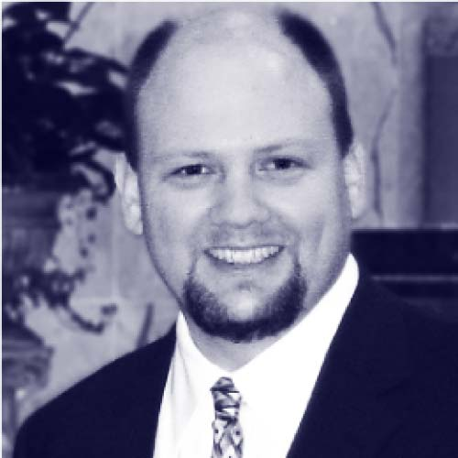

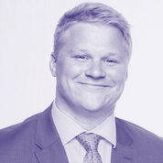

Introductions.
Oliver Halter Partner
Jordan Katz Partner
Erich Klotz Senior Director
Carlo Sanchez Director
Daniela Terrizzi, PhD, RN Manager
30 years experience in enterprise tech
Leader of Manifold’s HealthCare practice
16 years experience in healthcare tech architecture & strategy
Experienced healthcare consultant
Ex-BCG, UofC MBA
Asst Prof UIC, 25 years healthcare experience
Fulbright Scholar
Tom Weakland Senior Advisor
Mary Van De Kamp Senior Advisor
Al Klein Senior Advisor
Kelly Pollard Senior Associate
James Zuercher Senior Associate
Led PwC’s Healthcare Advisory Practice
Former Chief Clinical Officer, Kindred HealthCare
30+ years experience in healthcare technology
RN and healthcare consultant MBA NYU Stern
Experienced healthcare consultant
UofC MBA

Slide 3
Introductions.
Oliver Halter Partner
Jordan Katz Partner
Erich Klotz Senior Director
Carlo Sanchez Director
Daniela Terrizzi, PhD, RN Manager
30 years experience in enterprise tech
Leader of Manifold’s HealthCare practice
16 years experience in healthcare tech architecture & strategy
Experienced healthcare consultant
Ex-BCG, UofC MBA
Asst Prof UIC, 25 years healthcare experience
Fulbright Scholar
Tom Weakland Senior Advisor
Mary Van De Kamp Senior Advisor
Al Klein Senior Advisor
Kelly Pollard Senior Associate
James Zuercher Senior Associate
Led PwC’s Healthcare Advisory Practice
Former Chief Clinical Officer, Kindred HealthCare
30+ years experience in healthcare technology
RN and healthcare consultant MBA NYU Stern
Experienced healthcare consultant
UofC MBA

Slide 4
Introductions.
Oliver Halter Partner
Jordan Katz Partner
Erich Klotz Senior Director
Carlo Sanchez Director
Daniela Terrizzi, PhD, RN Manager
30 years experience in enterprise tech
Leader of Manifold’s HealthCare practice
16 years experience in healthcare tech architecture & strategy
Experienced healthcare consultant
Ex-BCG, UofC MBA
Asst Prof UIC, 25 years healthcare experience
Fulbright Scholar
Tom Weakland Senior Advisor
Mary Van De Kamp Senior Advisor
Al Klein Senior Advisor
Kelly Pollard Senior Associate
James Zuercher Senior Associate
Led PwC’s Healthcare Advisory Practice
Former Chief Clinical Officer, Kindred HealthCare
30+ years experience in healthcare technology
RN and healthcare consultant MBA NYU Stern
Experienced healthcare consultant
UofC MBA

Slide 5
Introductions.
Oliver Halter Partner
Jordan Katz Partner
Erich Klotz Senior Director
Carlo Sanchez Director
Daniela Terrizzi, PhD, RN Manager
30 years experience in enterprise tech
Leader of Manifold’s HealthCare practice
16 years experience in healthcare tech architecture & strategy
Experienced healthcare consultant
Ex-BCG, UofC MBA
Asst Prof UIC, 25 years healthcare experience
Fulbright Scholar
Tom Weakland Senior Advisor
Mary Van De Kamp Senior Advisor
Al Klein Senior Advisor
Kelly Pollard Senior Associate
James Zuercher Senior Associate
Led PwC’s Healthcare Advisory Practice
Former Chief Clinical Officer, Kindred HealthCare
30+ years experience in healthcare technology
RN and healthcare consultant MBA NYU Stern
Experienced healthcare consultant
UofC MBA

Slide 6
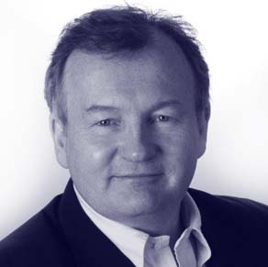
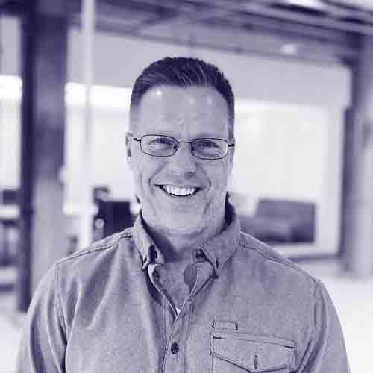

Our commercial due diligence team.
John Sviokla
Partner, Advisory
30+ years as consultant, executive, board member, and investor. Former CMO for PwC US. Masters and PhD from Harvard Business School, Former Harvard professor.
Jordan Katz
Partner, Advisory
17+ years as consultant and business P&L owner. Former Chief of Staff at Active Network, where he led to a successful IPO in 2011. Kellogg alum.
Carlo Sanchez,
Sr. Director, Advisory
10+ years as strategy consultant and business operator.
Deep expertise in growth strategy and due diligence. Former consulting leader at BCG and Booth alum.
Dan Hallstrom,
Director, Analytics
20+ years in the design, development and production implementation analytical solutions.
Former North Carolina State University Professor and PwC Director.
Felipe Platzer
Manager, Advisory
6+ years in consulting. Focus areas include commercial due diligence and growth strategy. Former consultant at BCG’s Principal Investments and Private Equity practice. Fuqua alum.
+ Advisory analysts, Manifold Ventures team, Advisory Network experts

Slide 7


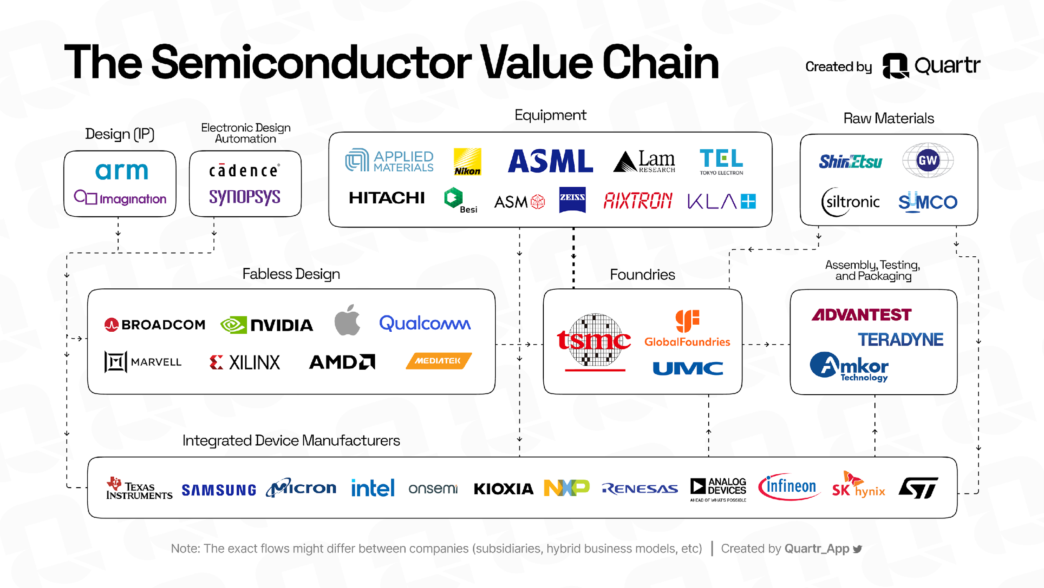







Main industry players (not exhaustive).
Core players
Suppliers
Design
Manufacturing
ATP¹
Design
Manufacturing
Fabless design firms
Foundries
OSAT² firms
Core IP
EDA³
Raw materials
Equipment
Integrated device manufacturers (IDMs)
7
1. ATP: Assembly, testing, and packaging 2. OSAT: Outsourced semiconductor assembly and test 3. Electronic design automation

Slide 8
Market expected to grow at 7% - 15% over the next few years.
Global semiconductor market size, in billion USD
High-end forecast: 15% CAGR
Low-end forecast: 7% CAGR
8
Source: WSTS, McKinsey

Slide 9

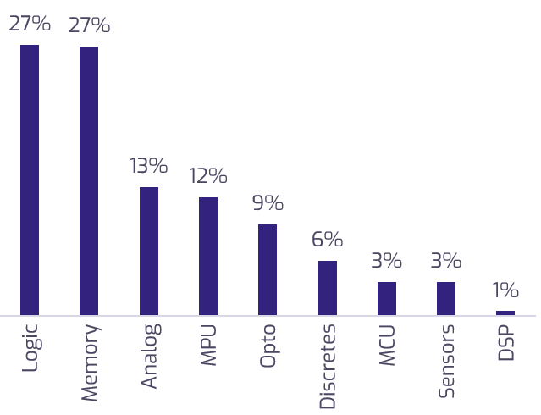
Segmentation by product type
Logic and memory chips make up >50% of the market.
Semiconductor market share, by product type¹
% of semiconductor sales, 2020
Product type description
Logic: Main building blocks of digital circuits. They perform basic logical operations like AND, OR, NOT, and XOR
Memory: Store data. Includes volatile memory (like RAM) and non-volatile memory (like flash memory and ROM)
Analog: Process analog signals. Used in audio amplification, radio transmission, and signal processing.
Microprocessor Units (MPU): Umbrella term that includes central processing units (CPUs), graphics processing units (GPUs), and others
Opto: Source, detect, and control light. Used in fiber-optic communications, display technology, and lighting
Discretes: Individual semiconductor devices like diodes and thyristors. Used in power management, switching, and amplification
Microcontroller Units (MCU): Similar to MPUs, but don’t need external support chips to create a complete embedded system
Sensors: Convert environmental variables such as temperature, pressure, into electrical signals
Digital Signal Processors (DSP): Specialized microprocessors designed to process digital signals. Used in audio and video processing, telecommunications, and control systems
Source: SIA, 2020.
9

Slide 10
Segmentation by product type
Logic and memory chips make up >50% of the market.
Semiconductor market share, by product type¹
% of semiconductor sales, 2020
Product type description
Logic: Main building blocks of digital circuits. They perform basic logical operations like AND, OR, NOT, and XOR
Memory: Store data. Includes volatile memory (like RAM) and non-volatile memory (like flash memory and ROM)
Analog: Process analog signals. Used in audio amplification, radio transmission, and signal processing.
Microprocessor Units (MPU): Umbrella term that includes central processing units (CPUs), graphics processing units (GPUs), and others
Opto: Source, detect, and control light. Used in fiber-optic communications, display technology, and lighting
Discretes: Individual semiconductor devices like diodes and thyristors. Used in power management, switching, and amplification
Microcontroller Units (MCU): Similar to MPUs, but don’t need external support chips to create a complete embedded system
Sensors: Convert environmental variables such as temperature, pressure, into electrical signals
Digital Signal Processors (DSP): Specialized microprocessors designed to process digital signals. Used in audio and video processing, telecommunications, and control systems
Source: SIA, 2020.
10

Slide 11
Several industry trends were identified.
Key industry trends
Geographic diversification of supply chain
Industry recovery and normalization
Increased cyberthreats
Partnerships between automotive and semiconductor companies
Talent shortage
Innovations in manufacturing and design process
Advanced node technologies
Semiconductor demand growth driven by AV/EVs
Growth of generative AI
ESG and sustainability improvements
Metaverse growth
Trends were identified using a compendium of documents representing analyst coverage, media coverage, and thought leadership articles from professional services firms
11

Slide 12



4 priority trends were identified based on impact on the industry and on KPMG’s business lines.
Trend | Impact on semiconductor industry | Impact on KPMG’s business lines
Geographic diversification of supply chain
Industry recovery and normalization
Increased cyberthreats
Automotive/semiconductor partnerships
Talent shortage
Innovations in manufacturing & design (incl. application of AI)
Advanced node technologies
Demand growth from automotive sector (AV/EV)
Demand growth from edge computing
Demand growth from 5G / 6G
Demand growth from generative AI
ESG and sustainability improvements
Metaverse growth
Prioritized for further analysis
Impact on semiconductor industry and relevance for KPMG’s business lines are based on qualitative analyses. Impact on semiconductor industry considers likelihood and impact of each trend
High
Medium
Low
12

Slide 13
Artificial intelligence, computing, and semiconductor chip technology are the most active startup segments.
Category | Total VC funding | # of startups | # of startup deals
Artificial intelligence
Computing
Semiconductor chip technology
Quantum
Semiconductor parts and components
Photonics
Connectivity, IOT
Mixed signal semiconductor
Micro electronics
Electronic equipment
Semiconductor manufacturing equipment
Other
13
Source: Pitchbook. Startups defined as companies founded in 2017 or later. Only deals in 2017 or later are included.

Slide 14

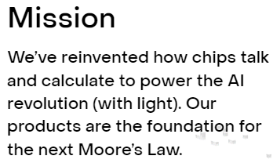
Start-up deep-dive: Lightmatter.
Founded in 2017
Headquartered in California, USA
Valued at $1.2billion
Developer of a light-powered chip designed to speed up artificial intelligence-driven computations by orders of magnitude
Key investors include Google Ventures, SIP Global Partners, Aliya Capital Partners, Hewlett Packard, and Fidelity
14

Slide 15
Corporate venture funds are key VC investors in semiconductors.
Top 10 investors with most deals¹
Top 10 investors participating in largest VC deals
Investor | # of semiconductor VC deals since 2019
Intel Capital | 30
Silicon Catalyst | 20
European Innovation Fund | 19
Samsung | 16
M Ventures (Merck VC) | 14
Qualcomm Ventures | 14
Quantonation | 14
Alumni Ventures | 14
Parkwalk Advisors | 13
Foothill Ventures | 13
SK Hynix | 13
Investor | Sum of semiconductor VC deal amounts since 2019
Intel Capital | $1.6b
M12 (Microsoft VC) | $1.1b
Qualcomm Ventures | $1b
Baillie Gifford | $983m
Temasek Holdings | $890m
In-Q-Tel | $866m
Alumni Ventures | $810m
Cambium Capital Mgmt. | $774m
SK Hynix | $753m
Hewlett Packard | $740m
Corporate venture funds
Please note: Amounts may not represent the amount actually invested by each company, since deals can have multiple investors
Other investors
Source: Pitchbook 1. Eleven investors shown, since two companies are tied for the 10th spot
15

Slide 16
All Big 4 firms are present in the semiconductor audit space, with EY and KPMG seeming to have a bigger presence.
Audit clients by firm¹
Deloitte
Arm
Marvell
TSMC
Winbond
EY
Advantest
Analog Devices
AMD
Intel
MediaTek
PwC
Amkor
ASML
Broadcom
Teradyne
KPMG
Applied Materials
ASM
GlobalFoundries
Infineon
16
1. Source: Companies’ 10k reports from latest fiscal year

Slide 17
Deloitte, Accenture, and Capgemini among the leaders in content generation, as well as KPMG, McKinsey, and BCG.
Topic relevance of semiconductor-related articles, by company
 | Average | Big 4 |  |  |  | MBB |  |  | Technology consulting |  |  |  | Mid-sized accounting
 |  | KPMG | Deloitte | EY | PwC | McK | BCG | Bain | Accent. | Capgem. | Cogniz. | Infosys | BDO | Grant T. | Mazars
Government investment | 0.46 | 0.59 | 0.60 | 0.53 | 0.47 | 0.58 | 0.61 | 0.30 | 0.54 | 0.49 | 0.33 | 0.44 | 0.31 | 0.30 | 0.34
Sustainability | 0.46 | 0.62 | 0.79 | 0.48 | 0.46 | 0.62 | 0.60 | 0.31 | 0.63 | 0.55 | 0.33 | 0.35 | 0.23 | 0.23 | 0.26
Talent retention | 0.44 | 0.56 | 0.60 | 0.45 | 0.42 | 0.60 | 0.57 | 0.32 | 0.59 | 0.49 | 0.39 | 0.41 | 0.24 | 0.24 | 0.24
Regulatory risks | 0.43 | 0.54 | 0.57 | 0.49 | 0.44 | 0.54 | 0.56 | 0.31 | 0.52 | 0.48 | 0.32 | 0.43 | 0.27 | 0.28 | 0.25
Cybersecurity | 0.39 | 0.49 | 0.52 | 0.45 | 0.43 | 0.52 | 0.51 | 0.24 | 0.48 | 0.48 | 0.33 | 0.42 | 0.20 | 0.24 | 0.20
Advanced node technologies | 0.36 | 0.49 | 0.53 | 0.39 | 0.35 | 0.53 | 0.53 | 0.19 | 0.48 | 0.45 | 0.26 | 0.27 | 0.14 | 0.17 | 0.20
Quantum computing | 0.36 | 0.57 | 0.59 | 0.33 | 0.26 | 0.63 | 0.58 | 0.15 | 0.54 | 0.56 | 0.20 | 0.23 | 0.12 | 0.13 | 0.11
IP risks | 0.35 | 0.46 | 0.48 | 0.42 | 0.37 | 0.47 | 0.49 | 0.23 | 0.44 | 0.41 | 0.23 | 0.34 | 0.17 | 0.19 | 0.16
Generative AI | 0.34 | 0.42 | 0.57 | 0.34 | 0.29 | 0.56 | 0.42 | 0.14 | 0.46 | 0.50 | 0.30 | 0.40 | 0.11 | 0.15 | 0.10
Geopolitical tensions | 0.34 | 0.49 | 0.47 | 0.48 | 0.36 | 0.48 | 0.48 | 0.20 | 0.42 | 0.38 | 0.20 | 0.29 | 0.16 | 0.11 | 0.24
Operational complexity | 0.34 | 0.45 | 0.48 | 0.37 | 0.32 | 0.48 | 0.48 | 0.22 | 0.45 | 0.41 | 0.24 | 0.28 | 0.16 | 0.27 | 0.16
5g / 6g networks | 0.31 | 0.46 | 0.51 | 0.33 | 0.31 | 0.44 | 0.40 | 0.14 | 0.44 | 0.49 | 0.24 | 0.24 | 0.10 | 0.12 | 0.13`
Average | 0.38 | 0.51 | 0.56 | 0.42 | 0.37 | 0.54 | 0.52 | 0.23 | 0.50 | 0.47 | 0.28 | 0.34 | 0.18 | 0.20 | 0.20
Note: Similarity scores represent the semantic similarity between an article and a topic. Values range from 0 to 1 . Scores are directional. They do not represent percentages or tangible metrics, and they should not be used to calculate composite metrics (e.g., ratio between relevance of two different topics)
17

Slide 18
Deloitte, Accenture, and Capgemini among the leaders in content generation, as well as KPMG, McKinsey, and BCG.
Topic relevance of semiconductor-related articles, by company
 | Average | Big 4 |  |  |  | MBB |  |  | Technology consulting |  |  |  | Mid-sized accounting
 |  | KPMG | Deloitte | EY | PwC | McK | BCG | Bain | Accent. | Capgem. | Cogniz. | Infosys | BDO | Grant T. | Mazars
Government investment | 0.46 | 0.59 | 0.60 | 0.53 | 0.47 | 0.58 | 0.61 | 0.30 | 0.54 | 0.49 | 0.33 | 0.44 | 0.31 | 0.30 | 0.34
Sustainability | 0.46 | 0.62 | 0.79 | 0.48 | 0.46 | 0.62 | 0.60 | 0.31 | 0.63 | 0.55 | 0.33 | 0.35 | 0.23 | 0.23 | 0.26
Talent retention | 0.44 | 0.56 | 0.60 | 0.45 | 0.42 | 0.60 | 0.57 | 0.32 | 0.59 | 0.49 | 0.39 | 0.41 | 0.24 | 0.24 | 0.24
Regulatory risks | 0.43 | 0.54 | 0.57 | 0.49 | 0.44 | 0.54 | 0.56 | 0.31 | 0.52 | 0.48 | 0.32 | 0.43 | 0.27 | 0.28 | 0.25
Cybersecurity | 0.39 | 0.49 | 0.52 | 0.45 | 0.43 | 0.52 | 0.51 | 0.24 | 0.48 | 0.48 | 0.33 | 0.42 | 0.20 | 0.24 | 0.20
Advanced node technologies | 0.36 | 0.49 | 0.53 | 0.39 | 0.35 | 0.53 | 0.53 | 0.19 | 0.48 | 0.45 | 0.26 | 0.27 | 0.14 | 0.17 | 0.20
Quantum computing | 0.36 | 0.57 | 0.59 | 0.33 | 0.26 | 0.63 | 0.58 | 0.15 | 0.54 | 0.56 | 0.20 | 0.23 | 0.12 | 0.13 | 0.11
IP risks | 0.35 | 0.46 | 0.48 | 0.42 | 0.37 | 0.47 | 0.49 | 0.23 | 0.44 | 0.41 | 0.23 | 0.34 | 0.17 | 0.19 | 0.16
Generative AI | 0.34 | 0.42 | 0.57 | 0.34 | 0.29 | 0.56 | 0.42 | 0.14 | 0.46 | 0.50 | 0.30 | 0.40 | 0.11 | 0.15 | 0.10
Geopolitical tensions | 0.34 | 0.49 | 0.47 | 0.48 | 0.36 | 0.48 | 0.48 | 0.20 | 0.42 | 0.38 | 0.20 | 0.29 | 0.16 | 0.11 | 0.24
Operational complexity | 0.34 | 0.45 | 0.48 | 0.37 | 0.32 | 0.48 | 0.48 | 0.22 | 0.45 | 0.41 | 0.24 | 0.28 | 0.16 | 0.27 | 0.16
5g / 6g networks | 0.31 | 0.46 | 0.51 | 0.33 | 0.31 | 0.44 | 0.40 | 0.14 | 0.44 | 0.49 | 0.24 | 0.24 | 0.10 | 0.12 | 0.13`
Average | 0.38 | 0.51 | 0.56 | 0.42 | 0.37 | 0.54 | 0.52 | 0.23 | 0.50 | 0.47 | 0.28 | 0.34 | 0.18 | 0.20 | 0.20
Note: Similarity scores represent the semantic similarity between an article and a topic. Values range from 0 to 1 . Scores are directional. They do not represent percentages or tangible metrics, and they should not be used to calculate composite metrics (e.g., ratio between relevance of two different topics)
18

Slide 19
Deloitte, Accenture, and Capgemini among the leaders in content generation, as well as KPMG, McKinsey, and BCG.
Topic relevance of semiconductor-related articles, by company
 | Average | Big 4 |  |  |  | MBB |  |  | Technology consulting |  |  |  | Mid-sized accounting
 |  | KPMG | Deloitte | EY | PwC | McK | BCG | Bain | Accent. | Capgem. | Cogniz. | Infosys | BDO | Grant T. | Mazars
Government investment | 0.46 | 0.59 | 0.60 | 0.53 | 0.47 | 0.58 | 0.61 | 0.30 | 0.54 | 0.49 | 0.33 | 0.44 | 0.31 | 0.30 | 0.34
Sustainability | 0.46 | 0.62 | 0.79 | 0.48 | 0.46 | 0.62 | 0.60 | 0.31 | 0.63 | 0.55 | 0.33 | 0.35 | 0.23 | 0.23 | 0.26
Talent retention | 0.44 | 0.56 | 0.60 | 0.45 | 0.42 | 0.60 | 0.57 | 0.32 | 0.59 | 0.49 | 0.39 | 0.41 | 0.24 | 0.24 | 0.24
Regulatory risks | 0.43 | 0.54 | 0.57 | 0.49 | 0.44 | 0.54 | 0.56 | 0.31 | 0.52 | 0.48 | 0.32 | 0.43 | 0.27 | 0.28 | 0.25
Cybersecurity | 0.39 | 0.49 | 0.52 | 0.45 | 0.43 | 0.52 | 0.51 | 0.24 | 0.48 | 0.48 | 0.33 | 0.42 | 0.20 | 0.24 | 0.20
Advanced node technologies | 0.36 | 0.49 | 0.53 | 0.39 | 0.35 | 0.53 | 0.53 | 0.19 | 0.48 | 0.45 | 0.26 | 0.27 | 0.14 | 0.17 | 0.20
Quantum computing | 0.36 | 0.57 | 0.59 | 0.33 | 0.26 | 0.63 | 0.58 | 0.15 | 0.54 | 0.56 | 0.20 | 0.23 | 0.12 | 0.13 | 0.11
IP risks | 0.35 | 0.46 | 0.48 | 0.42 | 0.37 | 0.47 | 0.49 | 0.23 | 0.44 | 0.41 | 0.23 | 0.34 | 0.17 | 0.19 | 0.16
Generative AI | 0.34 | 0.42 | 0.57 | 0.34 | 0.29 | 0.56 | 0.42 | 0.14 | 0.46 | 0.50 | 0.30 | 0.40 | 0.11 | 0.15 | 0.10
Geopolitical tensions | 0.34 | 0.49 | 0.47 | 0.48 | 0.36 | 0.48 | 0.48 | 0.20 | 0.42 | 0.38 | 0.20 | 0.29 | 0.16 | 0.11 | 0.24
Operational complexity | 0.34 | 0.45 | 0.48 | 0.37 | 0.32 | 0.48 | 0.48 | 0.22 | 0.45 | 0.41 | 0.24 | 0.28 | 0.16 | 0.27 | 0.16
5g / 6g networks | 0.31 | 0.46 | 0.51 | 0.33 | 0.31 | 0.44 | 0.40 | 0.14 | 0.44 | 0.49 | 0.24 | 0.24 | 0.10 | 0.12 | 0.13`
Average | 0.38 | 0.51 | 0.56 | 0.42 | 0.37 | 0.54 | 0.52 | 0.23 | 0.50 | 0.47 | 0.28 | 0.34 | 0.18 | 0.20 | 0.20
Note: Similarity scores represent the semantic similarity between an article and a topic. Values range from 0 to 1 . Scores are directional. They do not represent percentages or tangible metrics, and they should not be used to calculate composite metrics (e.g., ratio between relevance of two different topics)
19

Slide 20
P2P | Systems Needed for STL Go-Live (Model 1: Inbound & Outbound via 3PL).
Preliminary
 | External Endpoints | SAP | Other systems | Manual / Excel | TBD
Credit application (Only needed for new vendors selling on credit)
Vendor creation (Only needed for new vendors)
P2P
Vendor: Credit app. processing
Credit application
Vendor: Credit app. approval
Approval notice
Vendor creation
PR generation (on GHQ)
PR generation
Only needed for OpEx (on Day 1)
PO generation
Vendor: PO receipt
PO approval
Vendor: Invoice generation
Invoice receipt
3PL: RM receipt & storage conf.
Invoice verification
Vendor: Payment receipt
Payment approval
Process applies to: KOH, NaOH (both types), packaging materials, cleaning supplies, spare parts Process does not apply to: BSG, utilities, labor, maintenance and repair orders, 3PL services
Information flow to / from outside
Information flow within Evergrain

Slide 21
P2P | Systems Needed for STL Go-Live (Model 1: Inbound & Outbound via 3PL).
Preliminary
 | External Endpoints | SAP | Other systems | Manual / Excel | TBD
Credit application (Only needed for new vendors selling on credit)
Vendor creation (Only needed for new vendors)
P2P
Vendor: Credit app. processing
Credit application
Vendor: Credit app. approval
Approval notice
Vendor creation
PR generation (on GHQ)
PR generation
Only needed for OpEx (on Day 1)
PO generation
Vendor: PO receipt
PO approval
Vendor: Invoice generation
Invoice receipt
3PL: RM receipt & storage conf.
Invoice verification
Vendor: Payment receipt
Payment approval
Process applies to: KOH, NaOH (both types), packaging materials, cleaning supplies, spare parts Process does not apply to: BSG, utilities, labor, maintenance and repair orders, 3PL services
Information flow to / from outside
Information flow within Evergrain

Slide 22
Summary
Potential problem | Piedmont | Marshfield | Methodist | Christiana | Wakemed | Multicare
Insufficient problem description | Not a problem | No data yet | No data yet | No data yet | No data yet | No data yet
Inaccurate problem coding | Problem | Problem | Problem | Problem | Problem | No data yet
Insufficient resolution description | No data yet | No data yet | Problem | No data yet | No data yet | No data yet
Inaccurate resolution coding | No data yet | Problem | No data yet | Not a problem | Problem | No data yet
WO closed right after opening | Problem | No data yet | Problem | Not a problem | Problem, but mainly because of after-hours | No data yet
No part number in WO needing parts | No data yet | No data yet | Not a problem | Problem | Problem | No data yet
Inaccurate downtime impact | No data yet | No data yet | No data yet | No data yet | No data yet | No data yet
Low remote fix rate | Not a problem | No data yet | No data yet | No data yet | No data yet | No data yet
Low fix right first time rate | Problem | No data yet | Problem | Problem | Problem | No data yet
WO’s transferred to other techs | Problem | No data yet | Not a problem | Not a problem | Not a problem | No data yet
PM takes longer than estimated | Problem | No data yet | Problem | No data yet | No data yet | No data yet
Date/time of service not recorded | Problem | Not a problem | Problem | Problem | Not a problem | No data yet
Labor cost not recorded | Problem | Not a problem | Problem | Not a problem | Not a problem | No data yet
Parts cost not recorded | Not a problem | Not a problem | Not a problem | Not a problem | Not a problem | No data yet
Asked customers to add missing data / alternative fields
Asked PS to get missing data from Nuvolo
Asked customer for incident data

Slide 23
Summary
Potential problem | Piedmont | Marshfield | Methodist | Christiana | Wakemed | Multicare
Insufficient problem description | Not a problem | No data yet | No data yet | No data yet | No data yet | No data yet
Inaccurate problem coding | Problem | Problem | Problem | Problem | Problem | No data yet
Insufficient resolution description | No data yet | No data yet | Problem | No data yet | No data yet | No data yet
Inaccurate resolution coding | No data yet | Problem | No data yet | Not a problem | Problem | No data yet
WO closed right after opening | Problem | No data yet | Problem | Not a problem | Problem, but mainly because of after-hours | No data yet
No part number in WO needing parts | No data yet | No data yet | Not a problem | Problem | Problem | No data yet
Inaccurate downtime impact | No data yet | No data yet | No data yet | No data yet | No data yet | No data yet
Low remote fix rate | Not a problem | No data yet | No data yet | No data yet | No data yet | No data yet
Low fix right first time rate | Problem | No data yet | Problem | Problem | Problem | No data yet
WO’s transferred to other techs | Problem | No data yet | Not a problem | Not a problem | Not a problem | No data yet
PM takes longer than estimated | Problem | No data yet | Problem | No data yet | No data yet | No data yet
Date/time of service not recorded | Problem | Not a problem | Problem | Problem | Not a problem | No data yet
Labor cost not recorded | Problem | Not a problem | Problem | Not a problem | Not a problem | No data yet
Parts cost not recorded | Not a problem | Not a problem | Not a problem | Not a problem | Not a problem | No data yet
Asked customers to add missing data / alternative fields
Asked PS to get missing data from Nuvolo
Asked customer for incident data

Slide 24

Manifold’s Core Framework.
We approach all of our engagements by focusing first on detailed discovery to fully understand the goals, landscape and stakeholder perspectives. We use that to define a desired end state and a plan to get there. We also have the team to help deliver the desired solution.
Business Objectives
Use
Cases
Target Operating Model
Iterative Plan
Change Management
Training
DISCOVER
DEFINE
DELIVER
ALIGN
ALIGN
Market Research
Current State
System Architecture
Mobilize Teams
User Feedback
Iterate
Agile Sprints
Discover current state and identify future opportunities.
Define Target Operating Model and implementation plan.
Iteratively deliver with confidence.

Slide 25
Our team’s relevant experience across xxx’s digital priorities.
 | Select Manifold projects |  | ERP implement. | Change management | Target state process design | Ecosystem / tech arch. | BI / D&A strategy | E-commerce
 | SAP implementation and process improvement
 | Process design and tech stack selection
 | Built AI engine for market landscape monitoring
 | eCommerce strategy and B2B portal solution management
 | Technology architecture assessment and design
 | Enterprise architecture transformation
 | Design and implementation of analytics-based workflows
1
✓
✓
✓
2
✓
✓
3
✓
✓
4
✓
✓
✓
5
✓
✓
✓
✓
6
✓
7
✓
25

Slide 26
Our team’s relevant experience across xxx’s digital priorities.
 | Select Manifold projects |  | ERP implement. | Change management | Target state process design | Ecosystem / tech arch. | BI / D&A strategy | E-commerce
 | SAP implementation and process improvement
 | Process design and tech stack selection
 | Built AI engine for market landscape monitoring
 | eCommerce strategy and B2B portal solution management
 | Technology architecture assessment and design
 | Enterprise architecture transformation
 | Design and implementation of analytics-based workflows
1
✓
✓
✓
2
✓
✓
3
✓
✓
4
✓
✓
✓
5
✓
✓
✓
✓
6
✓
7
✓
26

Slide 27
Overall Project Timeline
Activity | Week | 1 | 2 | 3 | 4 |  | 5 | 6 |  | 7 | 8
 | Date | 6/16 | 6/23 | 6/30 | 7/7 |  | 7/14 | 7/21 |  | 7/28 | 8/4
Kickoff & Alignment
Stakeholder Interviews
Argano Data Analysis
Competitive Research
Qualitative Research Design
Qualitative Interviews
Quantitative Research Design
Quantitative Data Collection
Analysis & Results Development
Recommendations Delivery
Today
Launch survey
Board Meeting Prep
Final Delivery

Slide 28
Overall Project Timeline
Activity | Week | 1 | 2 | 3 | 4 |  | 5 | 6 |  | 7 | 8
 | Date | 6/16 | 6/23 | 6/30 | 7/7 |  | 7/14 | 7/21 |  | 7/28 | 8/4
Kickoff & Alignment
Stakeholder Interviews
Argano Data Analysis
Competitive Research
Qualitative Research Design
Qualitative Interviews
Quantitative Research Design
Quantitative Data Collection
Analysis & Results Development
Recommendations Delivery
Today
Launch survey
Board Meeting Prep
Final Delivery

Slide 29
Overall Project Timeline
Activity | Week | 1 | 2 | 3 | 4 |  | 5 | 6 |  | 7 | 8
 | Date | 6/16 | 6/23 | 6/30 | 7/7 |  | 7/14 | 7/21 |  | 7/28 | 8/4
Kickoff & Alignment
Stakeholder Interviews
Argano Data Analysis
Competitive Research
Qualitative Research Design
Qualitative Interviews
Quantitative Research Design
Quantitative Data Collection
Analysis & Results Development
Recommendations Delivery
Today
Launch survey
Board Meeting Prep
Final Delivery

Slide 30
Main industry players (not exhaustive).
Core players
Suppliers
Design
Manufacturing
ATP¹
Design
Manufacturing
Fabless design firms
Foundries
OSAT² firms
Core IP
EDA³
Raw materials
Equipment
Integrated device manufacturers (IDMs)
30
1. ATP: Assembly, testing, and packaging 2. OSAT: Outsourced semiconductor assembly and test 3. Electronic design automation

Slide 31
Our approach.
Secondary research
Primary research
Synthesis and strategy development
31

Slide 32
Our approach.
1
2
3
Secondary research
Primary research
Synthesis and strategy development
32

Slide 33
Our approach.
Secondary research
Primary research
Synthesis and strategy development
33

Slide 34
Our approach.
1
2
3
Secondary research
Primary research
Synthesis and strategy development
34

